Slide 1

Research Storage Simplified

Slide 2

View the Slides
https://github.com/ResearchComputing/hpc_fundamentals_micro_credential/tree/main/asking_for_help

Slide 3


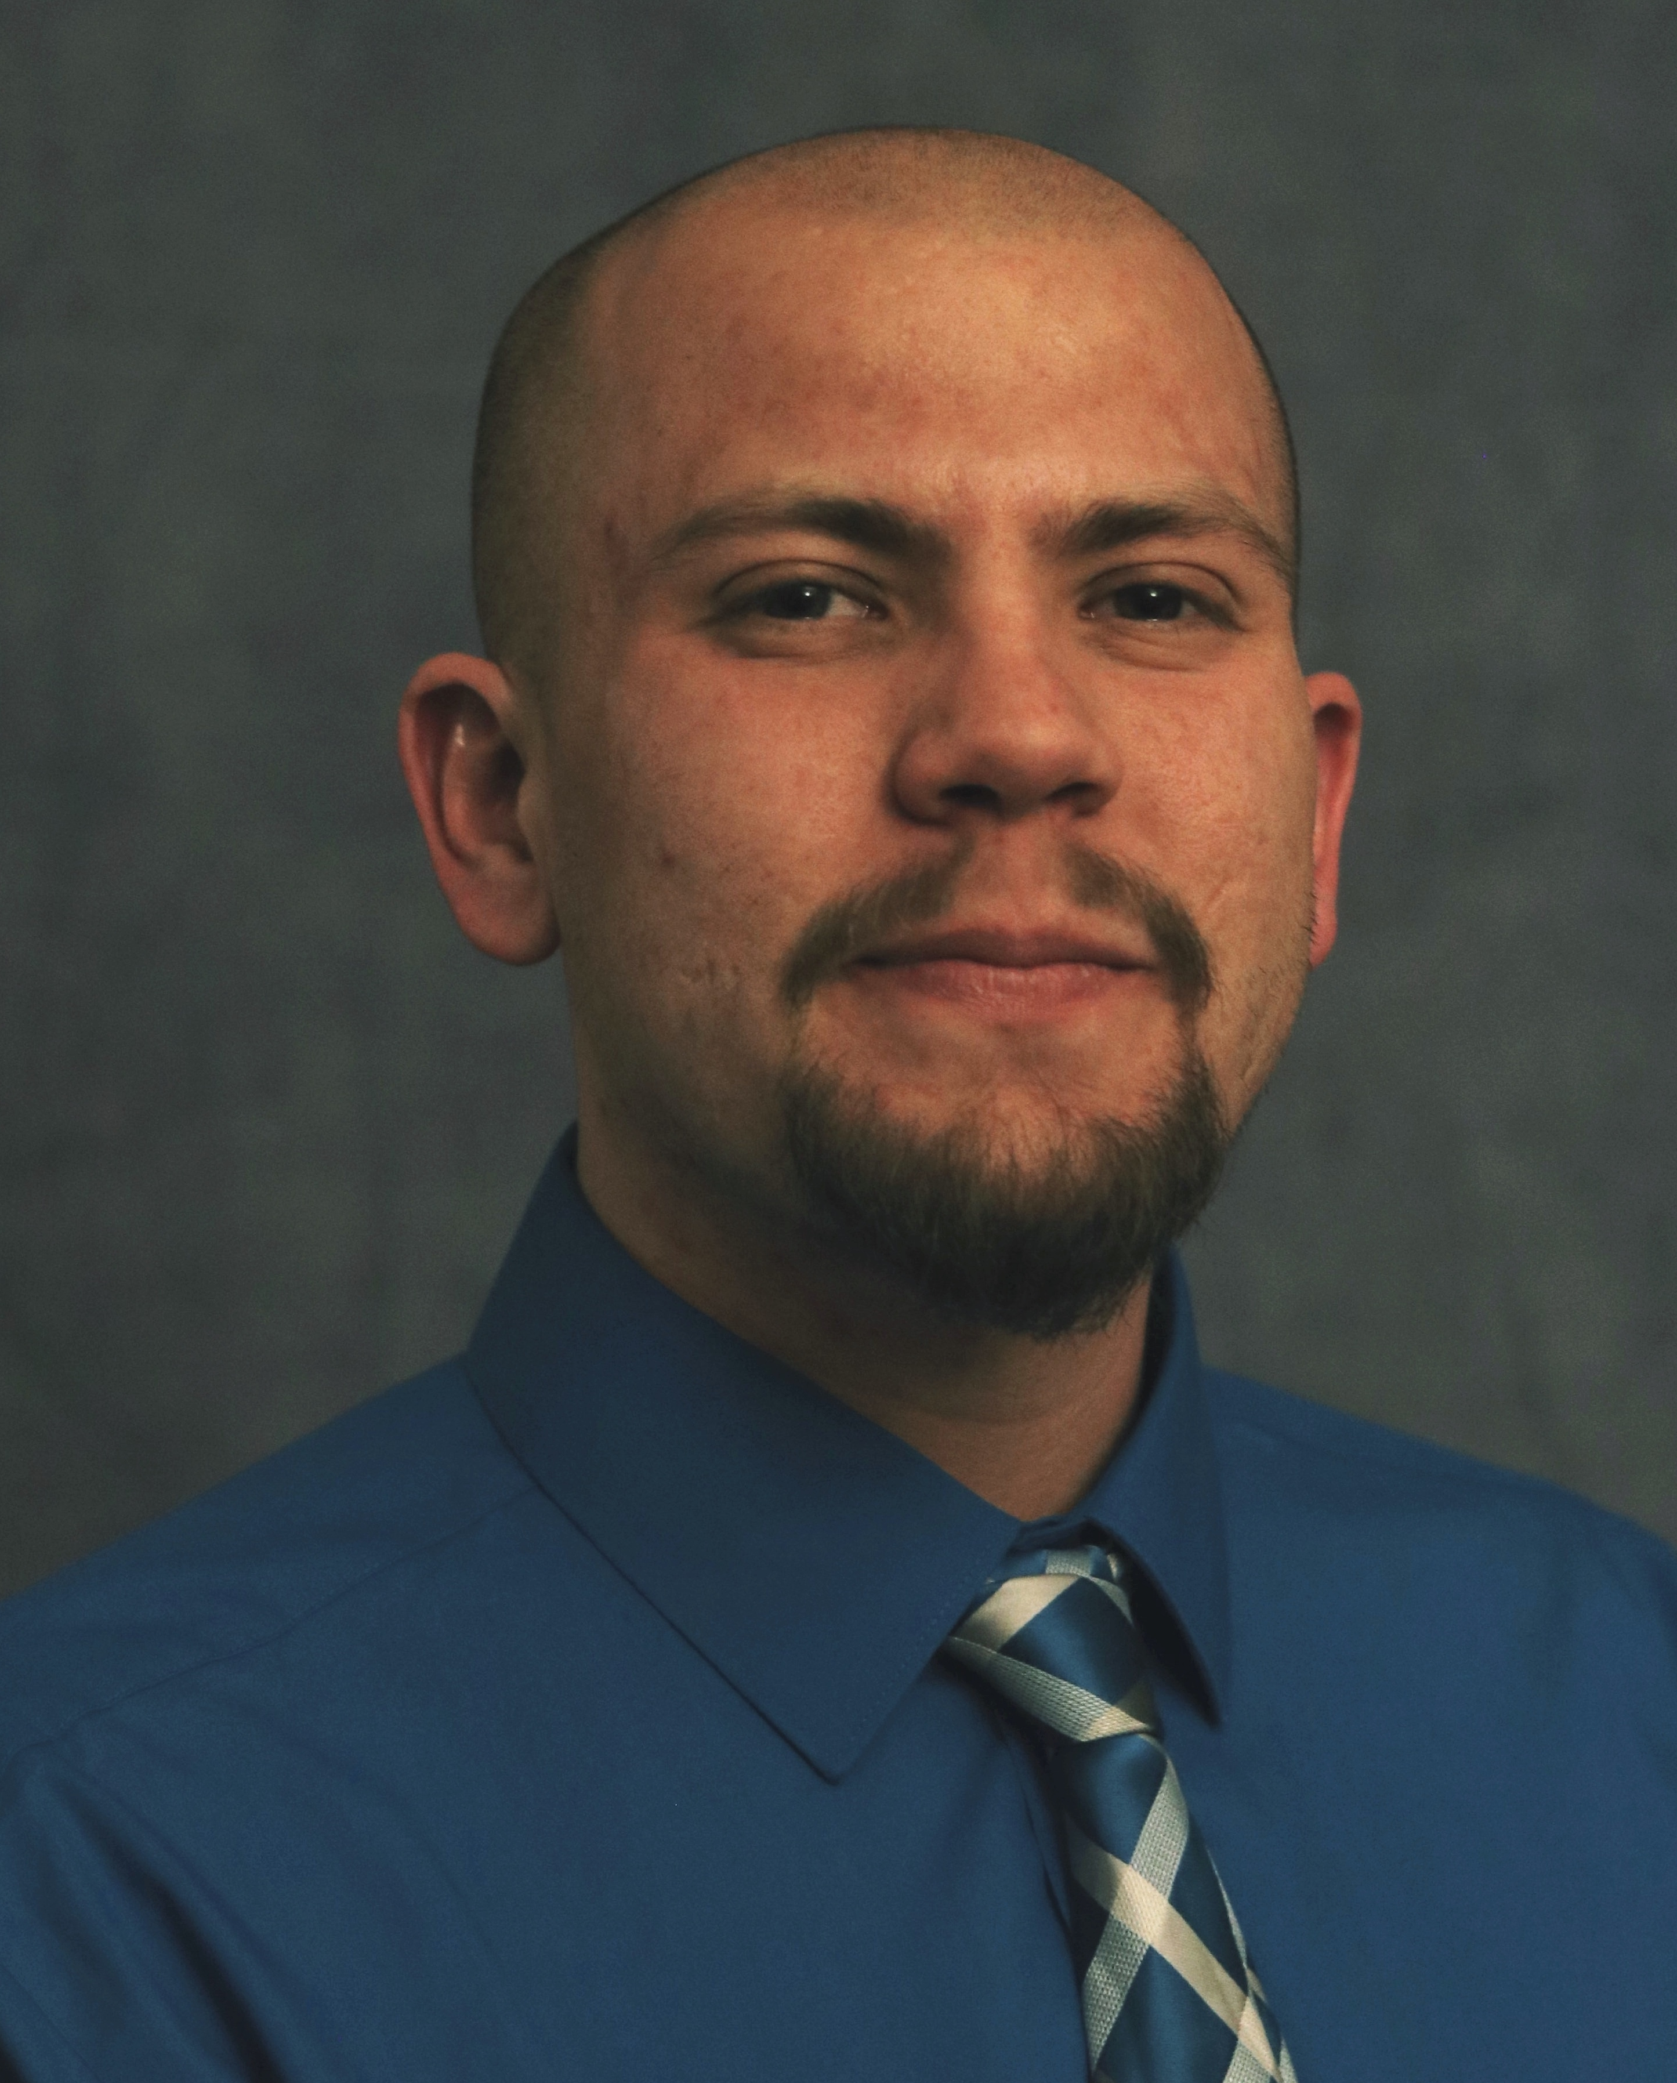



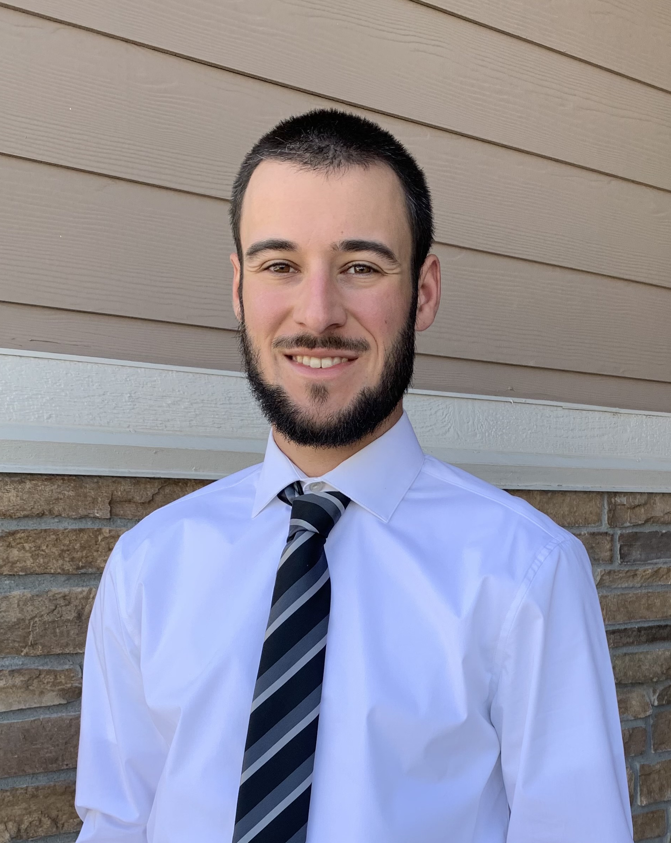


Meet the User Support Team
Layla Freeborn
Brandon Reyes
Andy Monaghan
Michael Schneider
John
Reiland
Dylan Gottlieb
Mohal Khandelwal
Ragan
Lee
3

Slide 4
Learning Objectives
What help resources do I have available?
How do I choose which resource is best?
How can I compose an effective ticket?

Slide 5

Things to take note of:
High-Performance Computing (HPC) can have confusing, ambiguous, highly nuanced concepts
CURC User Support is here to alleviate some of the confusion around HPC!
Ask Questions!

Slide 6
Help! I’m stuck, where do I go?
CURC Documentation: curc.readthedocs.io
External Resources
Rocky Mountain Advanced Computing Consortium (RMACC) Cyber Infrastructure Portal
The Internet! (Stack Overflow, YouTube, etc.)
Trainings & Consults with Center for Research Data and Digital Scholarship (CRDDS)
CURC Helpdesk: rc-help@colorado.edu

Slide 7
When should I use these?
Documentation: curc.readthedocs.io
Useful at any time! Check the documentation first when you run into issues.
External Resources
Useful for learning a new skill or initial troubleshooting. Great first place to look.
Trainings with Center for Research Data and Digital Scholarship
Useful for broad, long-term learning
Drop-in consult hours are held Tue (12-1p) and Thu (1-2p) during the Fall and Spring semesters
CURC Helpdesk: rc-help@colorado.edu
Useful for quick, personalized assistance. We can schedule Zoom consults if needed.

Slide 8
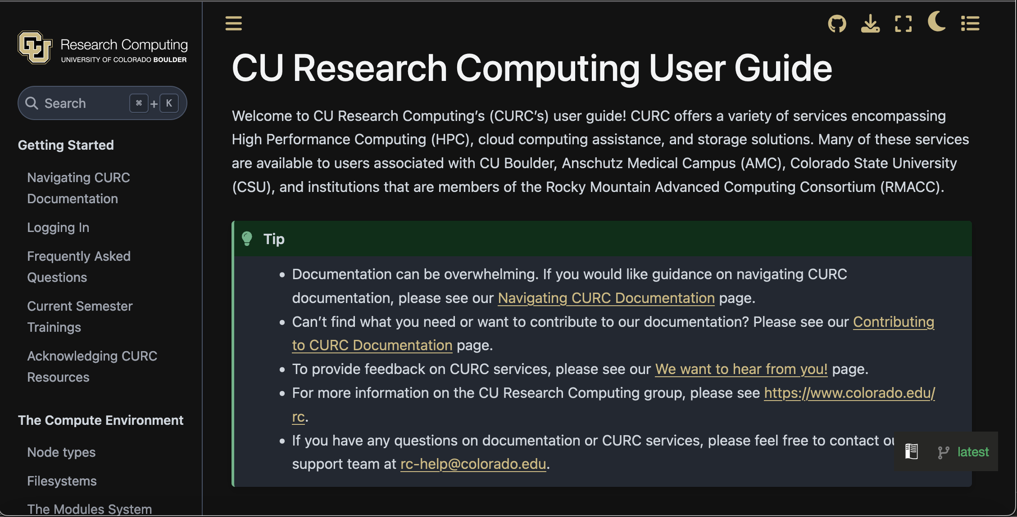
Our Documentation
Located at: https://curc.readthedocs.io

Slide 9
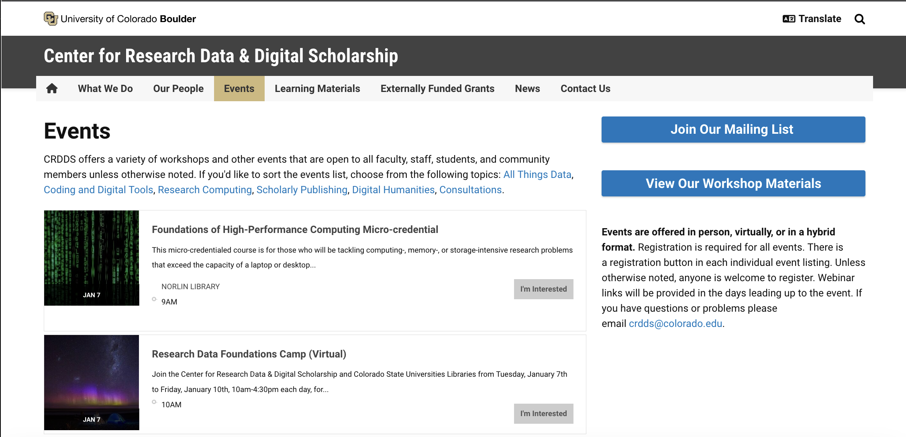
CRDDS trainings and consult hours
View upcoming events at: https://buff.link/crddsevents

Slide 10
Composing an Effective Ticket

Slide 11
Helpdesk Tickets: sub-optimal vs optimal (1)
To: rc-help@colorado.edu
Dear Research Computing,
Help! My code won’t run! Help!
Help please, Andy
To: rc-help@colorado.edu
Dear Research Computing,
I am running into issues running my Python script. I am using a conda environment called my_python_env with the pytorch software, and I am receiving the following error. I am not sure how to troubleshoot. My job ID is 620350. Let me know what I can try!
srun: fatal: SLURM_MEM_PER_CPU, SLURM_MEM_PER_GPU, and SLURM_MEM_PER_NODE are mutually exclusive.
Thanks, Andy

Slide 12
How can I compose an effective ticket? (1)
Provide detail!
Specify your goal, your Job ID (if applicable), and the issue you are encountering.
Specific error messages, error codes, or descriptions of behavior are all helpful. The more information you can provide, the better.
Provide job specifics!
Which environment or software are you using? What hardware are you taking advantage of? The more information you can provide, the better.

Slide 13
Helpdesk Tickets: sub-optimal vs optimal (2)
To: rc-help@colorado.edu
Dear Research Computing,
Hello, I am having trouble running my job. My job ID is 620350. The job loads in 1 TB of data, on which I am running some scikit-learn operations. The job has a wall clock time of 96 hours.
Thanks, Andy
To: rc-help@colorado.edu
Dear Research Computing,
Hello, I am having trouble running my job. My job ID is 620350. The job loads in 1 TB of data, on which I am running some scikit-learn operations. I have provided a 10GB test dataset here. The job has a wall clock time of 96 hours, but can be run with the smaller dataset in two hours.
Thanks, Andy
[attachment: File (10GB)]

Slide 14
How can I compose an effective ticket? (2)
Provide detail!
Scale down your workflows for testing!
It is a challenge to quickly troubleshoot massive workflows, even for us.
If you’d like us to test your workflows using data, please provide a reduced version of the data for testing purposes.

Slide 15
Helpdesk Tickets: sub-optimal vs optimal (3)
To: Andrew.Monaghan@colorado.edu
Dear Research Computing,
I am running into issues running my Python script. I am using a conda environment called my_python_env with the pytorch software, and I am receiving the following error. I am not sure how to troubleshoot. My job ID is 620350. Let me know what I can try!
srun: fatal: SLURM_MEM_PER_CPU, SLURM_MEM_PER_GPU, and SLURM_MEM_PER_NODE are mutually exclusive.
Thanks, Andy
To: rc-help@colorado.edu
Dear Research Computing,
I am running into issues running my Python script. I am using a conda environment called my_python_env with the pytorch software, and I am receiving the following error. I am not sure how to troubleshoot. My job ID is 620350. Let me know what I can try!
srun: fatal: SLURM_MEM_PER_CPU, SLURM_MEM_PER_GPU, and SLURM_MEM_PER_NODE are mutually exclusive.
Thanks, Andy

Slide 16
How can I compose an effective ticket? (3)
Provide detail!
Scale down your workflows for testing!
Email our helpdesk!
We will be significantly more responsive to emails which arrive at our helpdesk than other inboxes.
Please do not email us personally. If an issue is particularly urgent, please indicate ‘URGENT’ in the subject line of your ticket.

Slide 17
Helpdesk Tickets: sub-optimal vs optimal (4)
To: rc-help@colorado.edu
Dear Research Computing,
Can you install pytorch for me?
Thanks, Andy
To: rc-help@colorado.edu
Dear Research Computing,
I am looking to utilize PyTorch to use in conjunction with AMD GPUs. I have tried an anaconda installation and have so far been unsuccessful. Could you please help me complete this install?
Thanks, Andy

Slide 18
How can I compose an effective ticket? (4)
Provide detail!
Scale down your workflows for testing!
Email our helpdesk!
Try a few things and let us know what you’ve tried!
We are not just being lazy – it helps us contextualize the issue.
We would likely try the same things as you – if you can eliminate potential solutions, it will help us get to a solution more quickly.

Slide 19
Items We’ve Covered
What help resources do I have available?
How do I choose which resource is best?
How can I compose an effective ticket?

